Slide 1
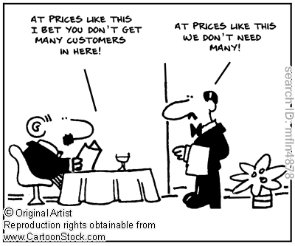
Toronto Restaurants
By the numbers
Author: Rafik Matta

Slide 2
What’s the problem?
How are Toronto's restaurants distributed by neighborhood?
What’s the distribution of Toronto’s restaurants?
What are the income and ethnic distributions of Toronto?
What type of restaurants does Toronto have?
Is it cheaper to eat in some neighborhoods and not others?
Do cheaper neighborhoods have worse quality restaurants?
How expensive/good are Toronto’s restaurants anyway? (Pie Charts)

Slide 3




Data Sources
https://www.toronto.ca/city-government/data-research-maps/open-data/open-data-catalogue/#8c732154-5012-9afe-d0cd-ba3ffc813d5a
https://www.yelp.com/dataset
https://developers.google.com/maps/documentation/geocoding/
http://www12.statcan.gc.ca/census-recensement/2016/dp-pd/prof/details/page.cfm?Lang=E&Geo1=CMACA&Code1=535&Geo2=PR&Code2=01&Data=Count&SearchText=toronto&SearchType=Begins&SearchPR=01&B1=Ethnic%20origin&TABID=1
https://www.toronto.ca/city-government/data-research-maps/open-data/open-data-catalogue/#a45bd45a-ede8-730e-1abc-93105b2c439f

Slide 4
Pre-processing
Extract Toronto ethnic and income data from the Census 2016 dataset to prepare Toronto level visualizations (this was done using Excel).
Convert ESRI Shape files to GeoJSON for use with Folium library
Convert Toronto Neighborhoods names into decimal coordinates using Google Maps API Geolocation feature
Append Yelp Restaurant’s Toronto Neighborhood based on proximity
Extract top neighborhoods with over 100 restaurants for comparative analysis
Apply filtering on the Neighborhood Profiles dataset to find ethnic and income information per neighborhood.
Apply filtering on the Yelp dataset with data from step 3 to create price and rating comparison charts.
Apply pivot methods and aggregations to count and find means.

Slide 5

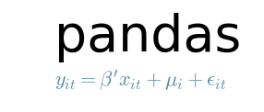




Tools Used

Slide 6
Restaurant Distribution

Slide 7
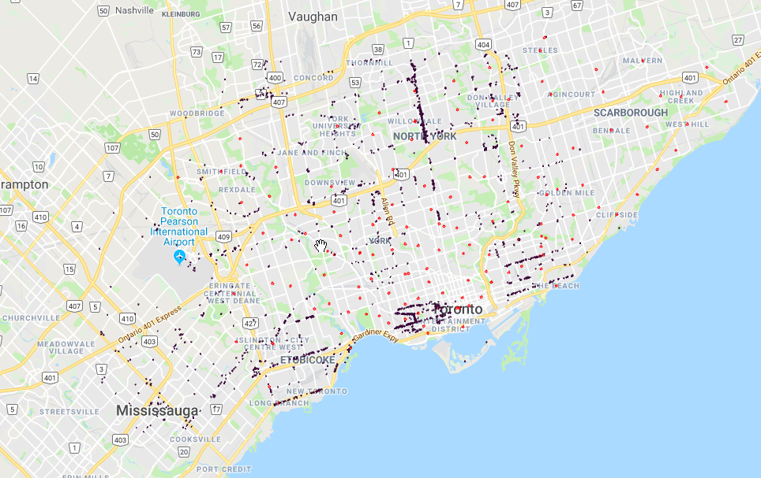
Where are all the restaurants?
--- Neighborhood centroid
--- Restaurant

Slide 8
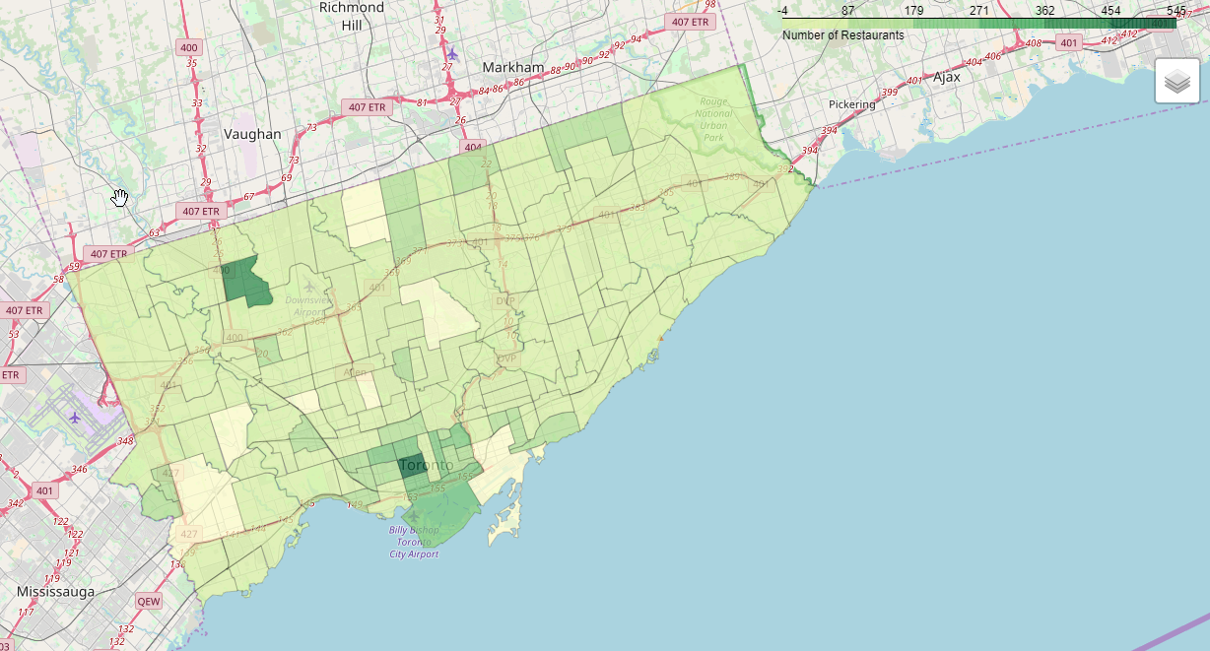
Where are all the restaurants?
Note: Open interactive Choropleth

Slide 9
Income

Slide 10
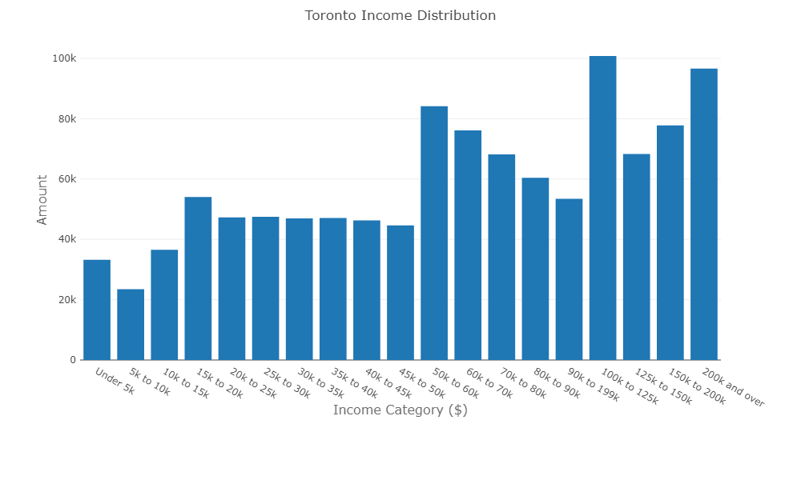
Toronto Income Dist.

Slide 11
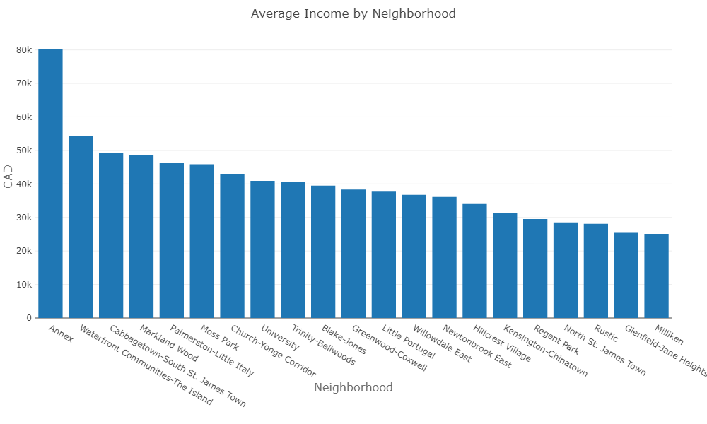
Income By Neigborhood

Slide 12
Ethnicities

Slide 13
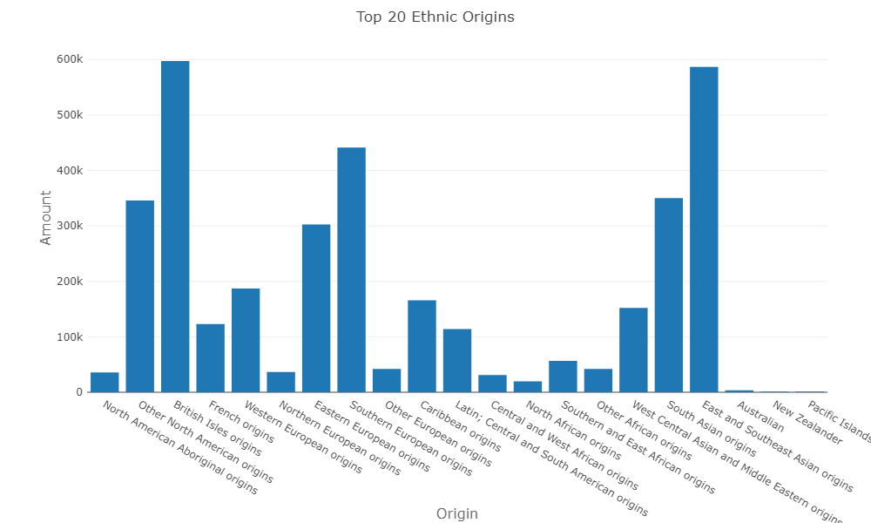
Top Ethnicities

Slide 14
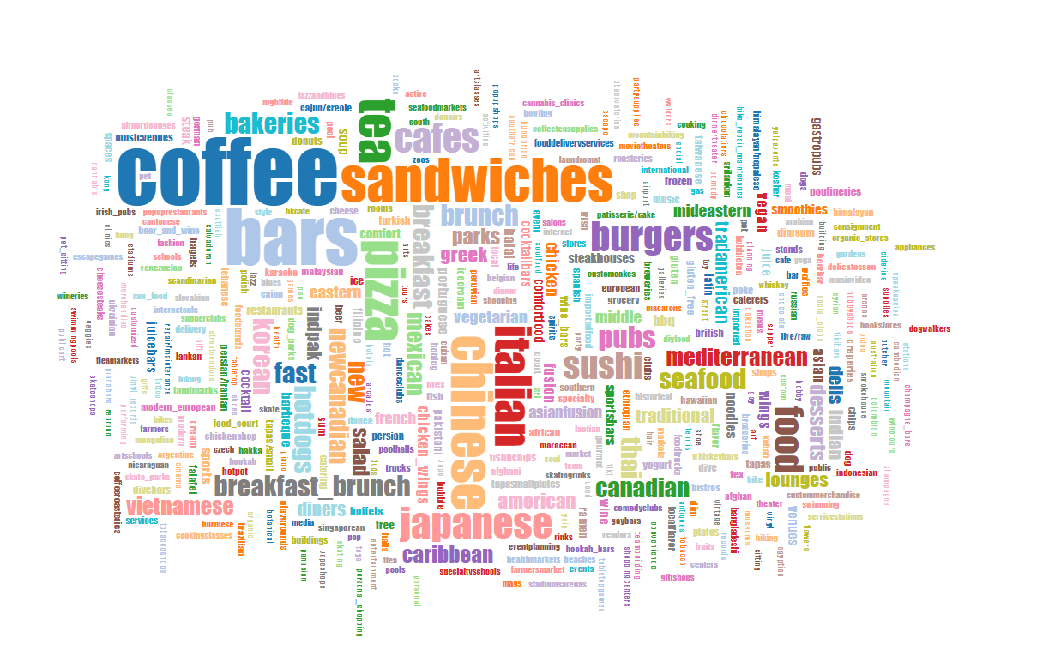
Top Restaurant Categories

Slide 15
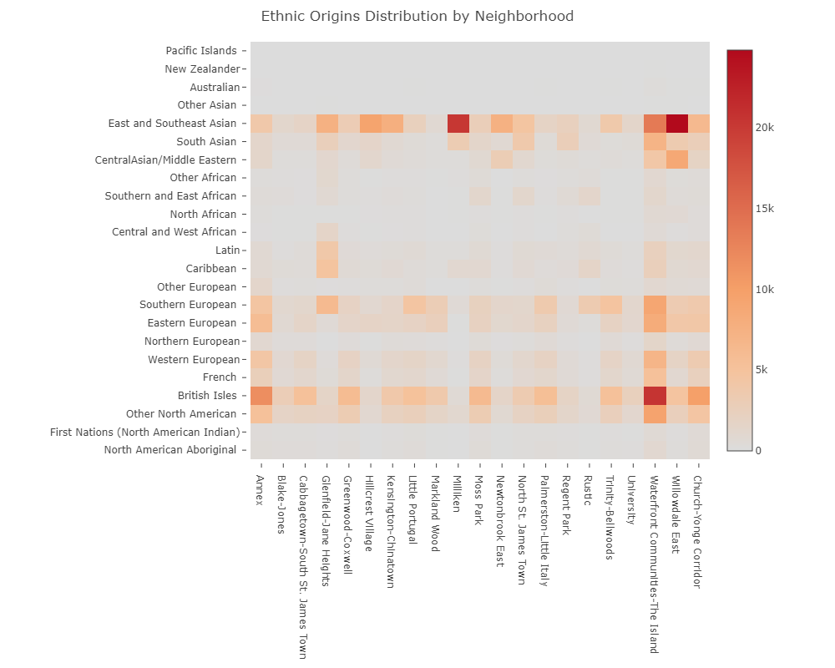
Ethnicities by Neighborhood

Slide 16
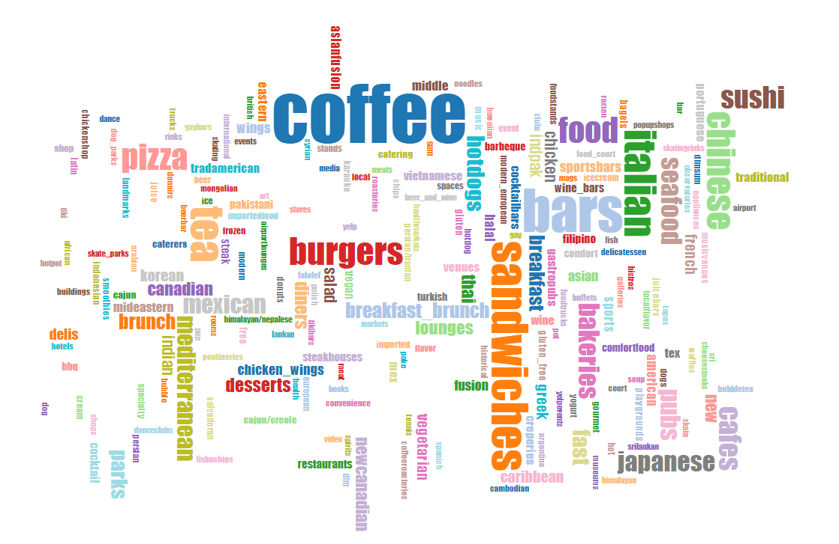
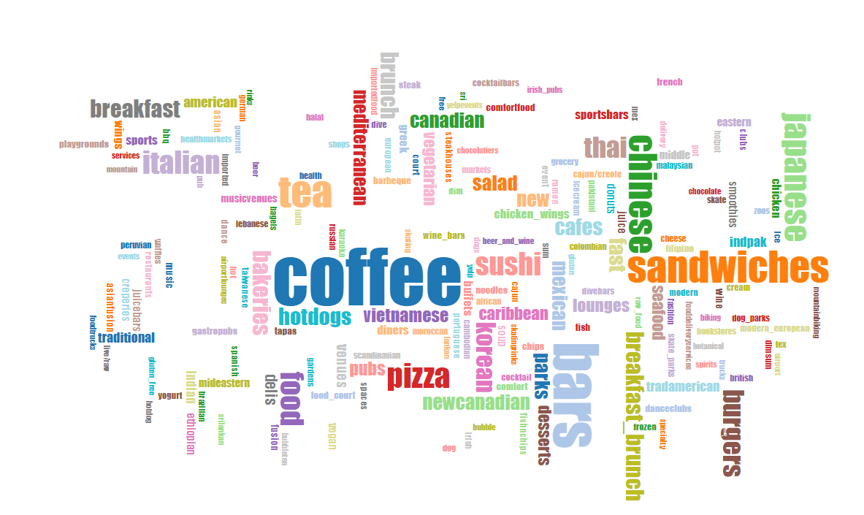
Top categories
Kensington-Chinatown
Glenfield-Jane Heights

Slide 17
Price vs. Rating

Slide 18
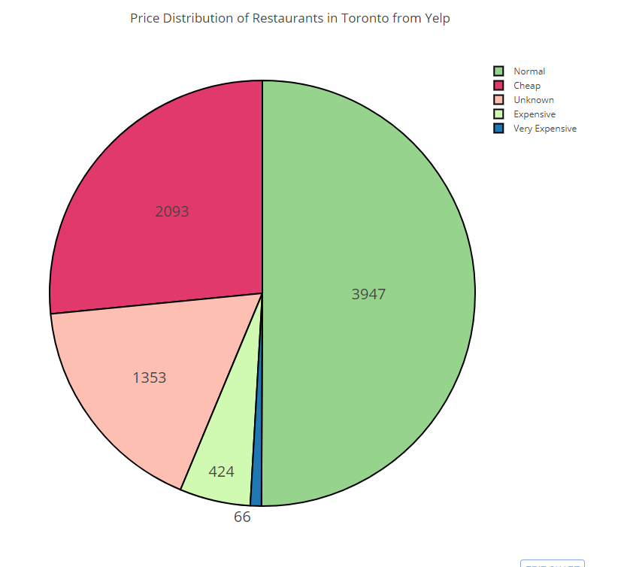
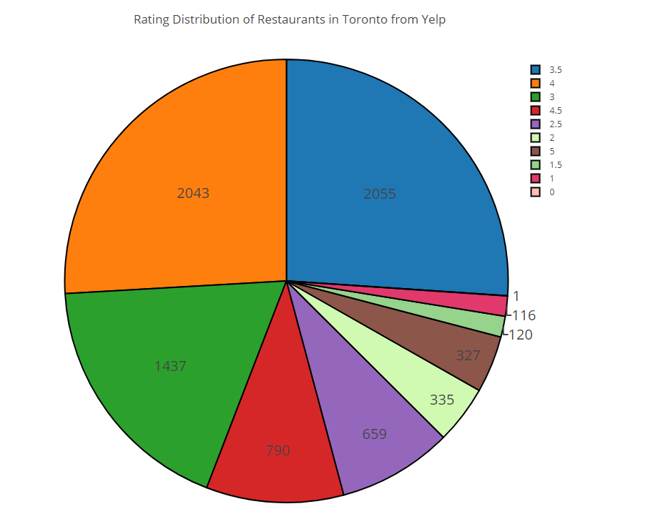
Toronto Restaurant Ratings Breakdown

Slide 19
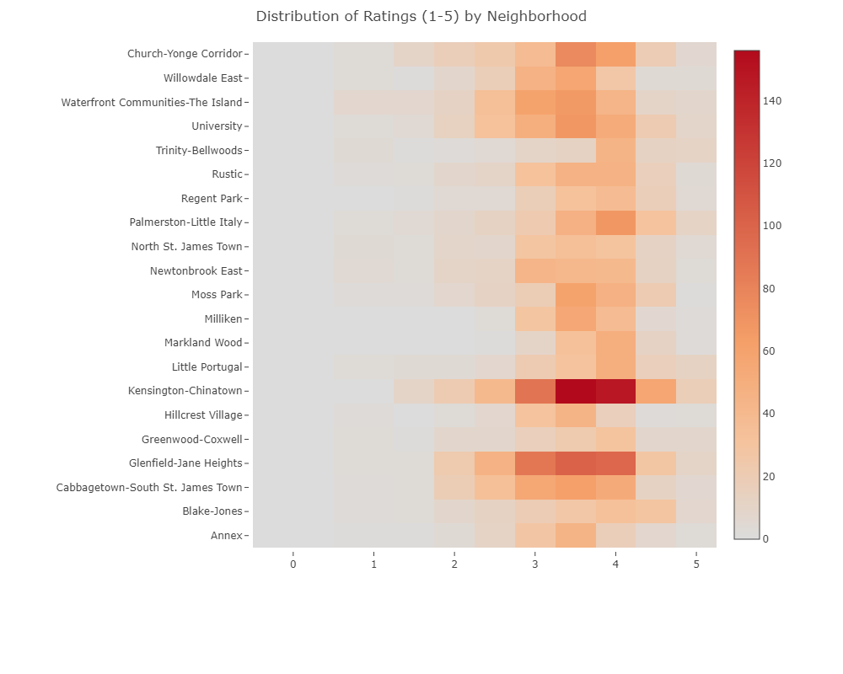
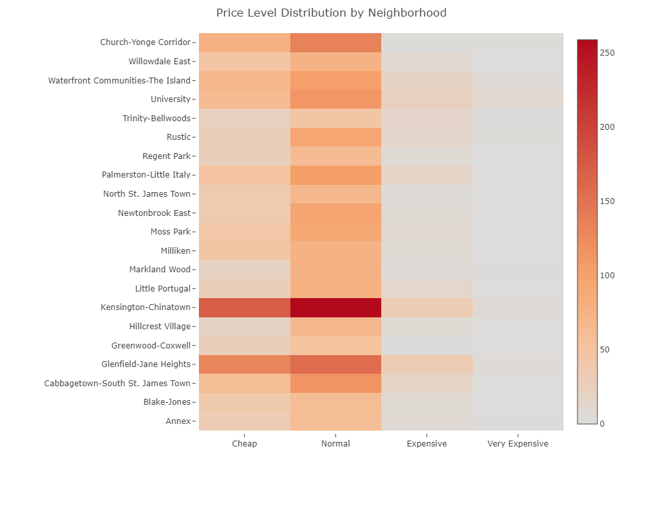
By Neighborhood

Slide 20
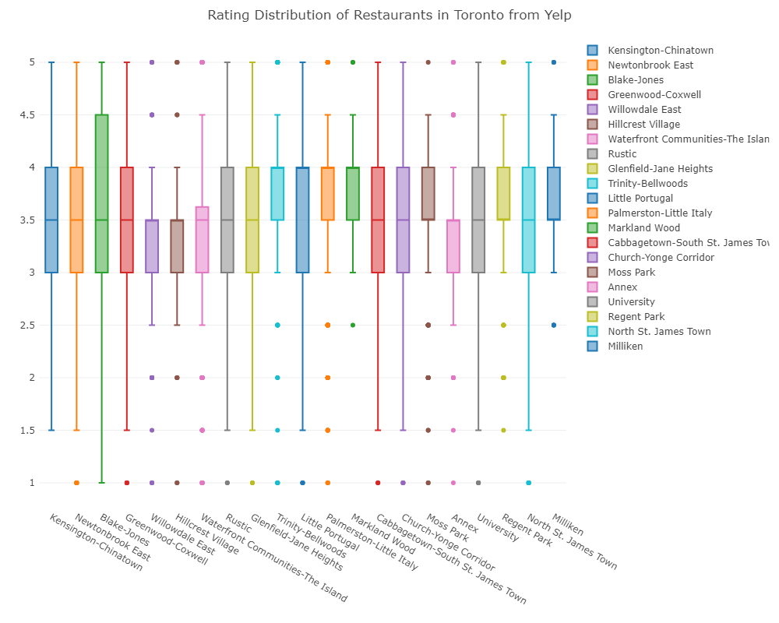
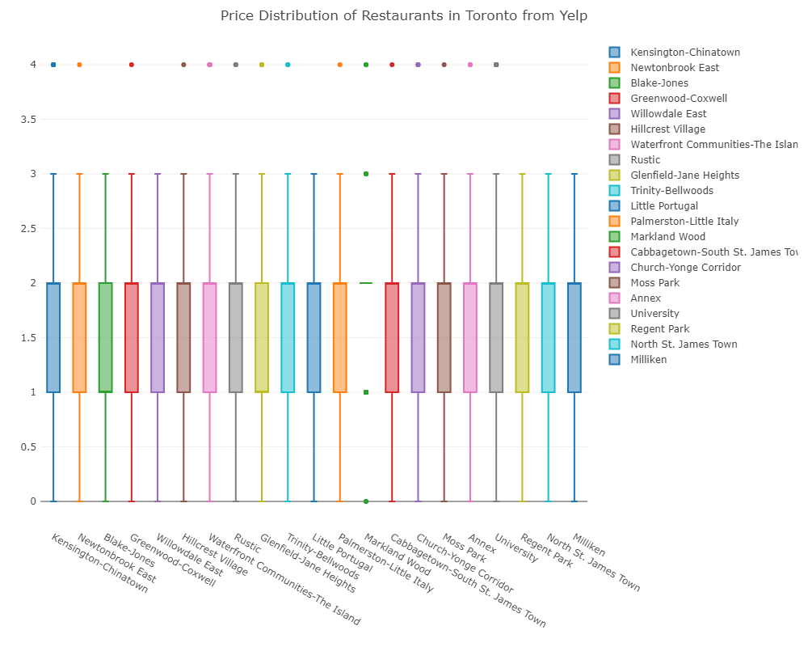
Boxplots of Ratings vs Price

Slide 21
Conclusions

Slide 22
Conclusions
Toronto has a big income distribution
Some neighborhoods are wealthier by a wide gap
Toronto is quite multicultural, but Asian origins dominate
Despite this, most popular restaurant type/category is…Coffee & Sandwiches!
Kensington-Chinatown and Glenfield-Jane Heights have most places to eat
Overall, price and ratings are somewhere in the middle
By neighborhood, price level is consistent, but ratings are not (more expensive isn’t better)

Slide 23
Lessons Learned

Slide 24
Lessons Learned
Finding good quality data is important in solving any problem
Excel can be easier/more efficient for data cleansing and extraction than most other tools
Watch out for Encoding!!!
Be flexible-I allowed the data to tell me it’s story and decided to share it with the others.
Data can serve more than one purpose
Visualizing a large number of attributes/variables is decidedly quite hard to do effectively
Pre-processing is paramount to preparing the data to be visualized, and almost always the hardest part

